Slide 1

PodKnow:
Data Statistics
Harini Booravalli
Christopher Edgecombe
Jeremy Hudson
Jamie Weathers
Kun Vincent Yang
Team Snack Overflow

Slide 2
Tasks Breakdown
Harini
Statistics and patterns observed in single words
LSA model applied on single words
LSA visualization and efficiency (in progress)
Christopher
Topic modeling using LDA for single words.
Visualization of LDA Model (Words)
Title Words in Podcast Content
Jeremy
Topic modeling using LDA with bigrams
Experimentation with different methods of creating bigrams
Statistical analysis using bigrams

Slide 3
Tasks Breakdown
Vincent
Google Statistics analysis of audio file length and transcription cost.
Jamie
New Collector app that includes valuable information (Confidence scores, audio length, etc..)
Analysis of Confidence Score Data
Notes:
Collector Application and Google Stats.

Slide 4
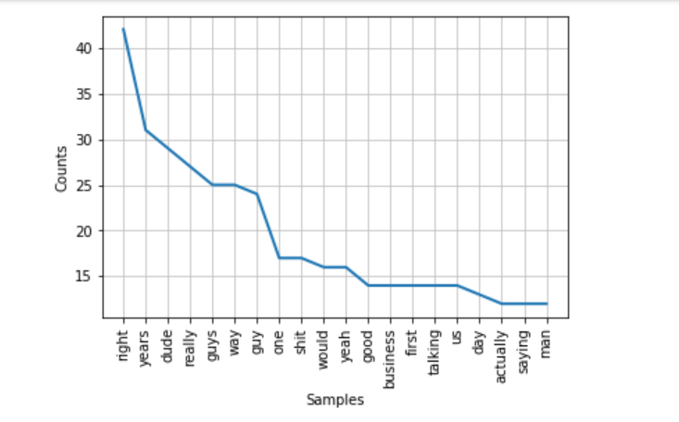
Harini
Statistics and patterns observed in single words
Statistical Observation----->Tf-IDf------->LSA
Mean,distribution,hypothesis tsting ----->LSA mode(coherence))
Considering the single words from podcasts after stop words removal.Performed it on all the podcasts.

Slide 5
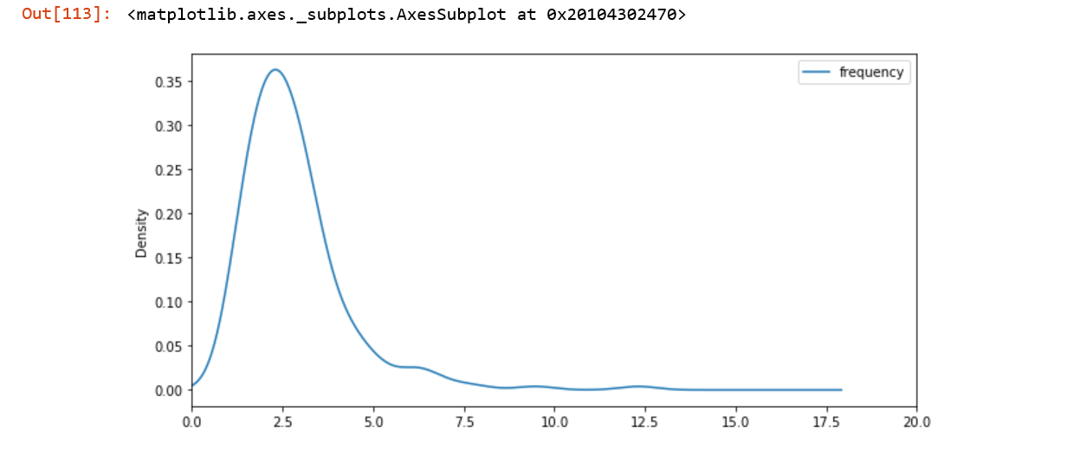
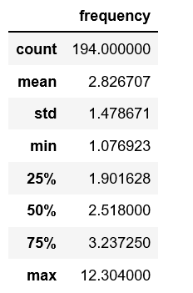
Harini
Statistics and patterns observed in single words
Mean frequency of words on all podcasts.

Slide 6
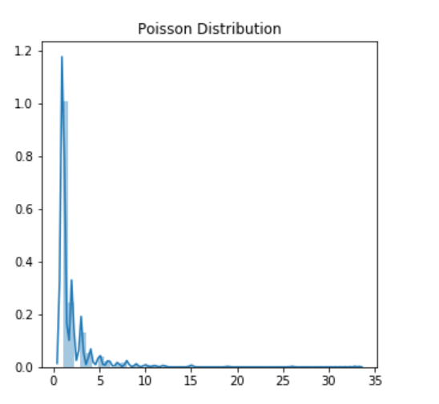
Harini
Distributions:-
Graph :- Word frequency v/s number of words
Poisson distribution applied.
Frequency of words and Number of words is discrete
Mean:- 2.016 ,SD:- 2.398

Slide 7
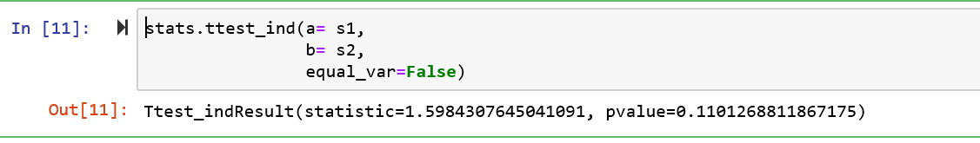
Harini:
Hypothesis Testing 1:
Null hypothesis: Frequency of word distribution is similar when the size of the podcast is same
Alternate Hypothesis : Frequency of word distribution is independent of the size of the podcast.
Consider 2 podcasts of same length and verify if the mean and word frequency is similar to see if the null hypothesis holds true.
Results below indicate the p value >0.5 and hence we cannot reject the null hypothesis

Slide 8
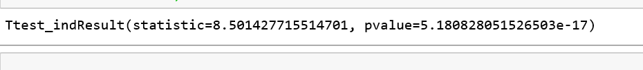
Harini:
Hypothesis Testing 2:
Null hypothesis: Frequency of word distribution is similar when the size of the podcast is varies
Alternate Hypothesis : Frequency of word distribution is dependent of the size of the podcast.
Consider 2 podcasts with different sizes.
Applying hypothesis testing :-
Here we see out p value is very less than 0.5 and hence reject null hypothesis.
Both the hypothesis testing results lead us to the fact that, frequency of words distribution is dependent on size of the podcast .

Slide 9
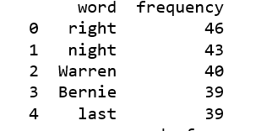
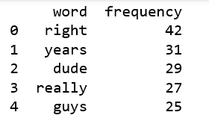
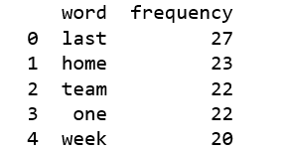
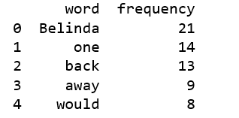
Observation:
Words below refers to the peak of the word frequency graph.
These words do not contribute much to the topic modelling.
Right , dude, last,would , week, can be used in any context doesn’t help us much.

Slide 10
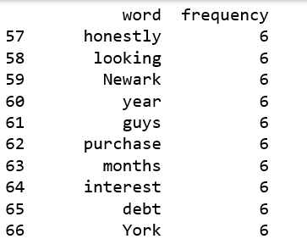
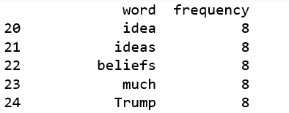
Observation:
Above screenshots show the words from same podcasts , which could give a much more meaning. Word frequency is much lesser .
These observations lead us to TF-TDF.
TF- IDF:- Term Frequency and Inverse document frequency.
TF:- The weight of a term that occurs in a document is simply proportional to the term frequency.
IDF:- The specificity of a term can be quantified as an inverse function of the number of documents in which it occurs.
Simple example From Data:- right low TF-IDF score.
Newark high TF-IDF score..

Slide 11
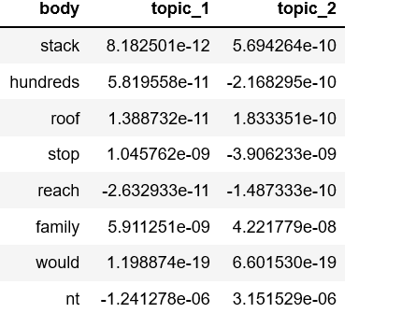
Harini
Latent Semantic Analysis(LSA)
LSA:-
LSA= TF-IDF +SVD(singular value decomposition)
Document matrix is formed using the TF-IDF score for each word.
To reduce the dimensionality of a matrix we use truncated SVD.

Slide 12
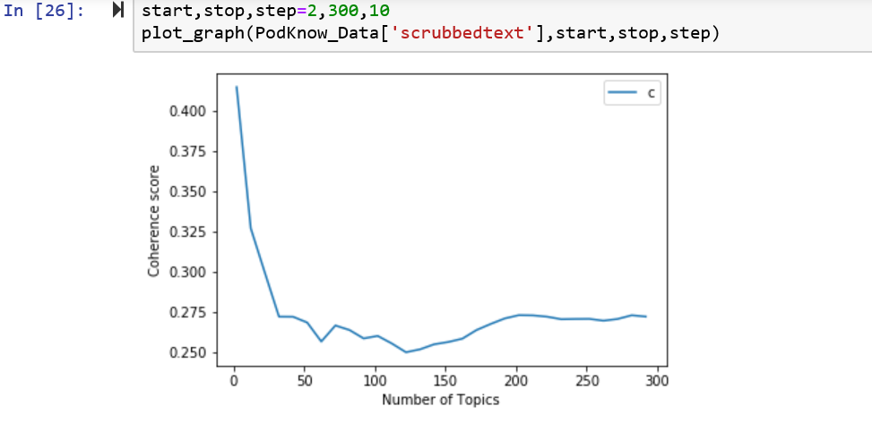
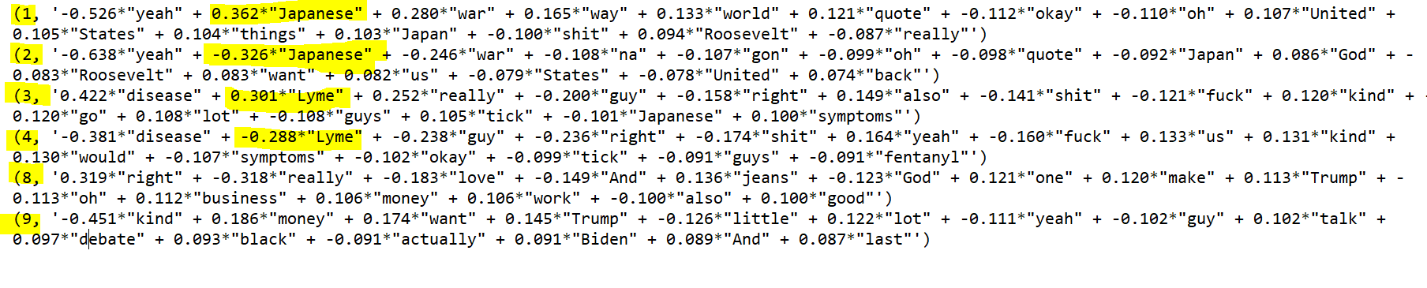
Harini
Results of LSA and Next Steps
Coherence measures the dependency of 2 signals.
Next Steps:-
Visualization and efficiency of LSA
Comparing it with LDA
Exploring a better topic model

Slide 13
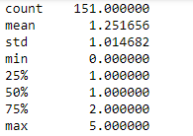
Christopher
Title vs Podcast Content Basic Statistics
Checking to see if the words from the title of the podcast appear within the podcast content.
How relevant is the title to the podcast?

Slide 14
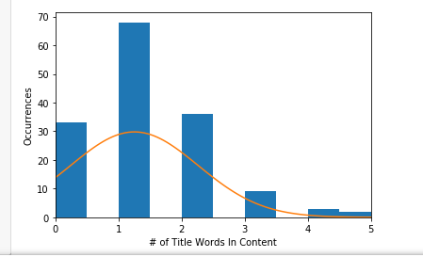
Christopher
Number of Title Words in Content vs Occurrences
Number of words from the title that were present in the content.
Occurrences over the 151 podcasts.

Slide 15
Christopher
Hypothesis Testing (One Sample z-test) / Correlation
Null Hypothesis: Mean number of words present in the title/podcast is = 1
Alternate Hypothesis: Mean number of words present in the title/podcast is > 1
Strong evidence to support the alternative hypothesis.
Correlation Test (Pearson’s Correlation Coefficient)
Comparing “Title_Length” with “Uniq_Length” to see if there is any correlation.
Can conclude that there is a positive linear relationship between title length and title words in podcasts content.

Slide 16
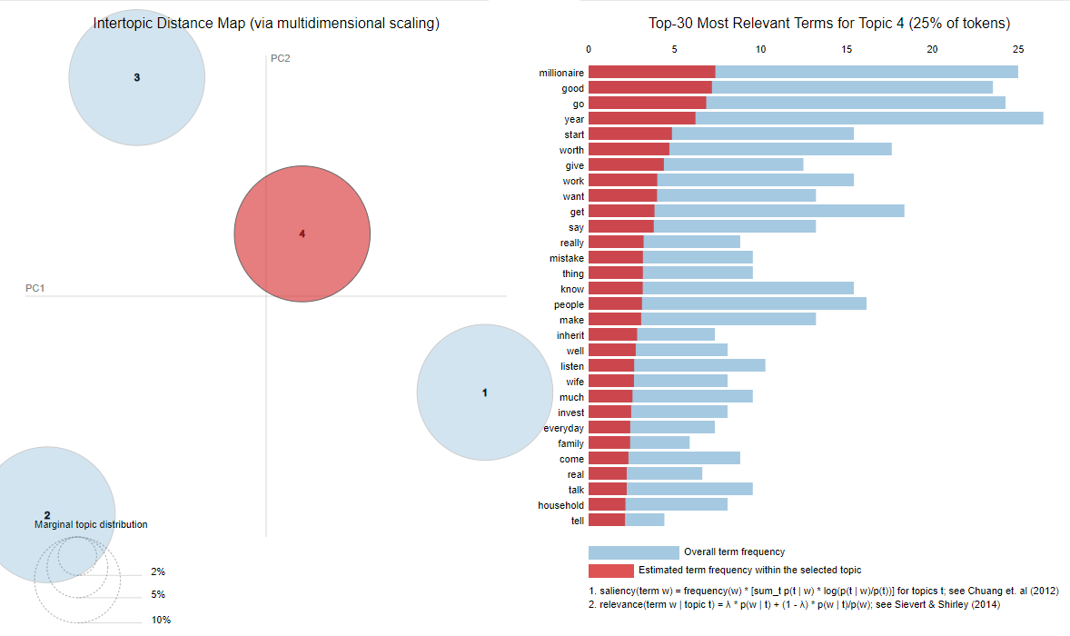
Christopher
LDA pyLDAvis Graph

Slide 17
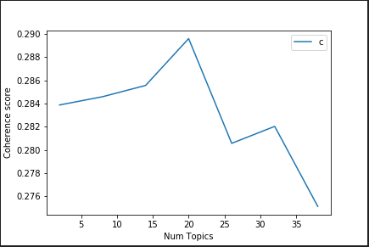
Christopher
LDA Coherence Score vs Topic Amount

Slide 18
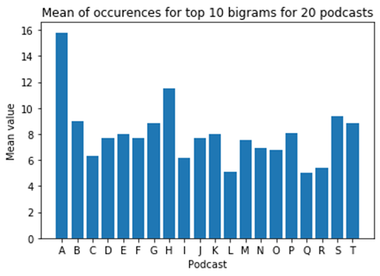
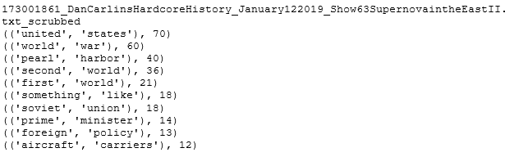
Jeremy
T 2.1 - Statistical Evaluation of Data
Acquired top 10 bigrams and calculated the mean of the occurrences of the top 10 bigrams per podcast to analyze topic discussion frequency
Variance of 5.8318
Low value: 5
High value: 15.8
Mean of all means taken is is 7.98

Slide 19
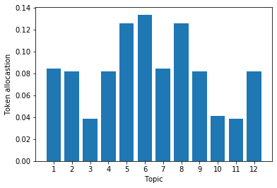
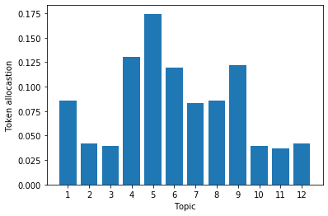
Jeremy
T 2.2 - Distribution Modeling
Many topic model distributions built from bigrams seem to roughly follow binomial or hypergeometric discrete distributions, as the model places primary confidence in a few topics, then gradually lower confidence in others
Wait wait… Don’t Tell me! The Ben Shapiro Show

Slide 20
Jeremy
T 2.3 - Hypothesis testing
Do related LDA models built from bigrams between similar podcasts (in this case crime related) have smaller differences between their topic probabilities as measured by the Hellinger distance equation in comparison to unrelated podcasts?
Null hypothesis - Hellinger results for crime will be similar to the population sample
Alternative hypothesis - Hellinger results for crime will be different from population sample
P - value is very low, so I reject the null hypothesis

Slide 21
Jeremy
T 2.4 - Correlation
Using Hellinger distance, we can compute the correlation between a topic and the remaining topics within another podcast
If the Hellinger distance is low, the correlation is low
If the Hellinger distance is high, the correlation is high
Using the Gensim diff function we can also print out common words between topics

Slide 22
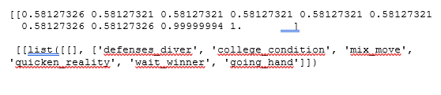
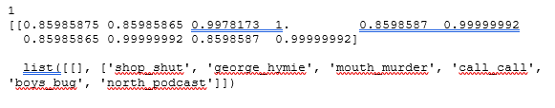
Jeremy
T 2.4 - Correlation
Unrelated Podcasts:
True Crime Podcasts:

Slide 23
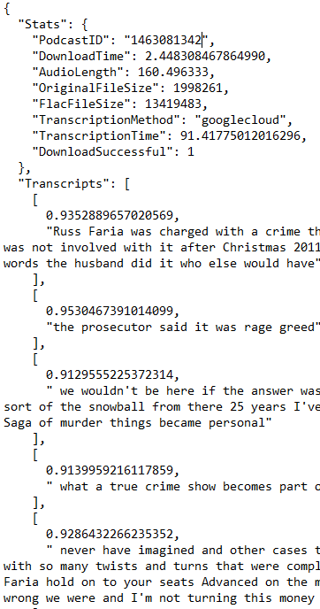
Jamie
Transcription Collector Rewrite
Needed more statistical data from the transcription process.
From a business perspective, this is valuable information because we can estimate and predict the cost of transcribing and storing audio files, and demonstrate how long the process will take.
Transcript Acquisition Data:
PodcastID, DownloadTime, Audio Length, Original File Size, Flac File Size, Transcription Method, Transcription Time, Download successful.
Transcripts: The confidence score followed by their transcript.

Slide 24
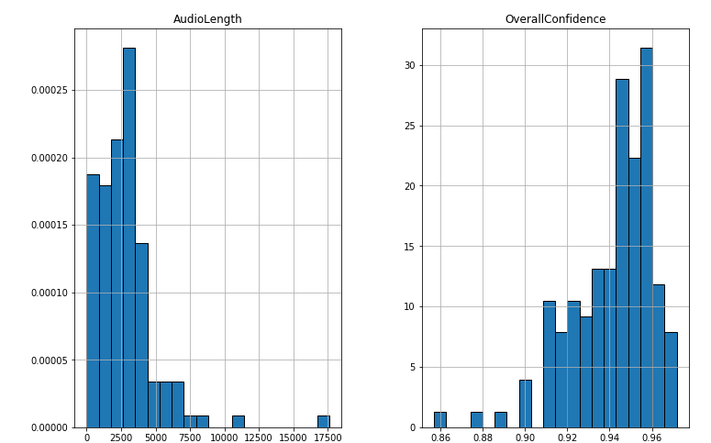
Jamie
Basic Statistics of Audio Length, Confidence Scores
Overall Confidence: The mean confidence score for the entire podcast.
Mean: 0.94124
Variance: 0.00039
Std dev: 0.01975
AudioLength: Duration of podcast in seconds
Mean: 2757.25
Variance: 4895670.35
Std Dev: 2212.61
*Generated from 133 samples.

Slide 25
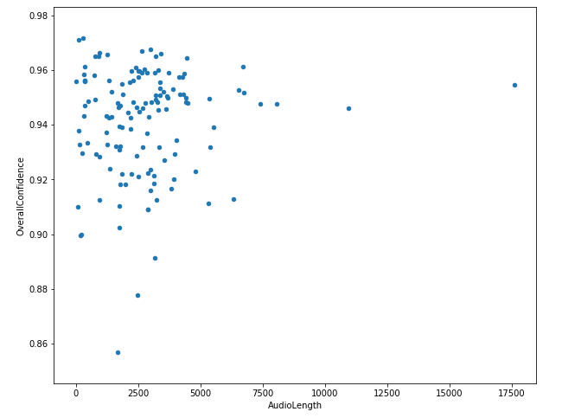
Jamie
Relationships
Is there a relationship between the length of a podcast and the overall confidence score?
Disappointingly, the answer appears to be no.
Hopeful for a correlation because I noticed some transcript "phrases" that were shorter had lower confidence scores.
Not the best approach because we're looking at a scatterplot of means. This was my "lazy" approach.

Slide 26
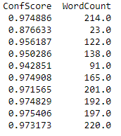
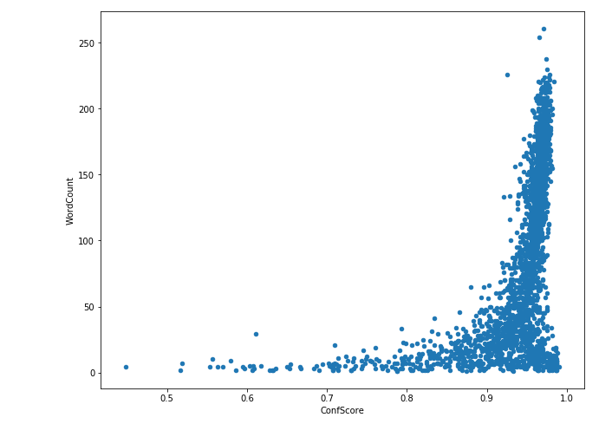
Jamie
Relationships
Second approach: Take the confidence score and see if there's a correlation between it and the word count of it's transcript phrase.
Performed across ALL podcast transcripts.
Looks like an exponential graph?

Slide 27
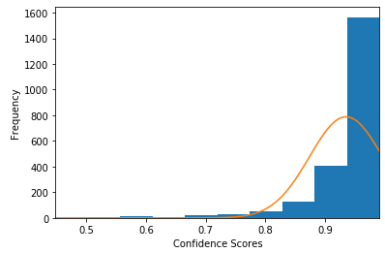
Jamie
Observations
Probability Distribution of Confidence Scores
In short, it's very likely Google Cloud can transcribe audio with high confidence.
326 transcript phrases with CS < 0.9 of 2228 (14.63%)

Slide 28
Jamie
Hypothesis Questions
There's many cases where there's a high CS and a low WC. Could Low WC and high CS be the result of pauses in a sentence, or when the speaker is very clear and/or has slow pronunciations of words?
Does the average of all confidence scores lie above or below the elbow point of the exponential curve?

Slide 29
Vincent
Task
Responsive in calculating the stats of google speech to text cost.
It is useful to understand the cost of each podcast.
Basic Stats of the total costs
Distribution models
Correlation and Co-variance
Hypothesis Testing

Slide 30
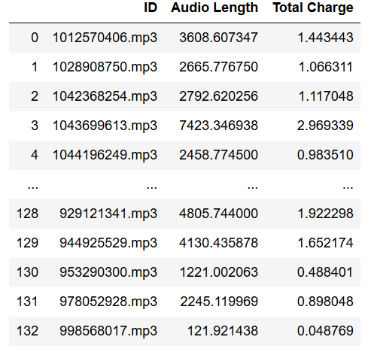
Vincent
Basic Stats
Mean: 1.1029031027909777
Variance: 0.777417
Median: 1.0134778624
STD: 0.8817129
Measures of Spread: 7.049205

Slide 31
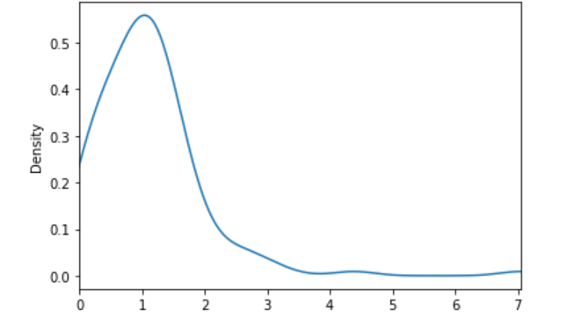
Vincent
Distribution Models: Density Plot

Slide 32
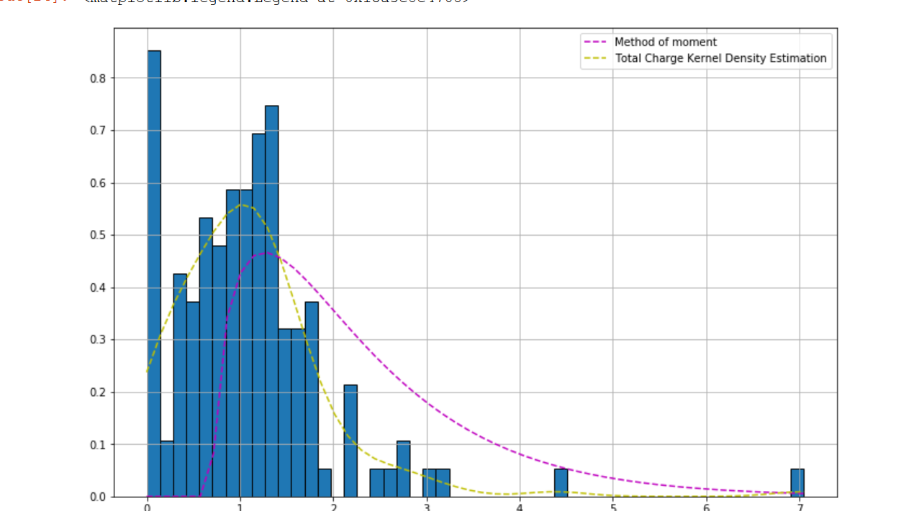
Vincent
Gamma Distribution

Slide 33
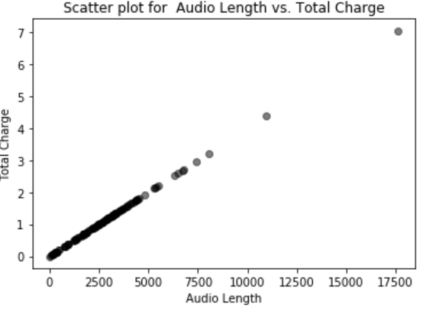
Vincent
Correlation
Since the data is calculated based on the Audio Length .
Cost = (AudioLength / 15 seconds) * 0.006 cent/sec.
Graph

Slide 34
Vincent
Hypothesis Testing
Pose The Question
What is the likely cost for each podcast?
Use current iteration as the sample size, then throughout the course, the application will have the ability to collect population size. Such that, the application can calculate the P-value with using one sample T-test.

Slide 35
Questions?

